Slide 1

Hadoop
By: Dr. Devpriya Soni
Department of Computer Science and Engineering & IT
Jaypee Institute of Information Technology, Noida
Notes:
Frequently, presenters must deliver material of a technical nature to an audience unfamiliar with the topic or vocabulary. The material may be complex or heavy with detail. To present technical material effectively, use the following guidelines from Dale Carnegie Training®.
Consider the amount of time available and prepare to organize your material. Narrow your topic. Divide your presentation into clear segments. Follow a logical progression. Maintain your focus throughout. Close the presentation with a summary, repetition of the key steps, or a logical conclusion.
Keep your audience in mind at all times. For example, be sure data is clear and information is relevant. Keep the level of detail and vocabulary appropriate for the audience. Use visuals to support key points or steps. Keep alert to the needs of your listeners, and you will have a more receptive audience.

Slide 2
Lecture will cover following points
Hadoop Characteristics
Hadoop Core Components
Characteristics
Features

Slide 3
Hadoop Characteristics
Easy to Use:
Distributed computing challenges are handled by framework
Client just need to concentrate on business logic
Economic
No need to purchase costly license
No need to purchase costly hardware
Scalability:
Vertical Scalability – New hardware can be added to the nodes
Horizontal Scalability – New nodes can be added on the fly
Data Locality:
Move computation to data instead of data to computation
Data is processed on the nodes where it is stored

Slide 4
Hadoop Characteristics
High Avalability:
Data is highly available and accessible despite hardware failure
There will be no downtime for end user application due to data availability
Reliability:
Data is reliably stored on the cluster of machines despite machine failures
Failure of nodes doesn’t cause data loss
Fault Tolerance:
Failure of nodes are recovered automatically
Framework takes care of failure of hardware as well tasks
Distributed processing:
Data is processed distributedly on cluster
Multiple nodes in the cluster process data independently

Slide 5
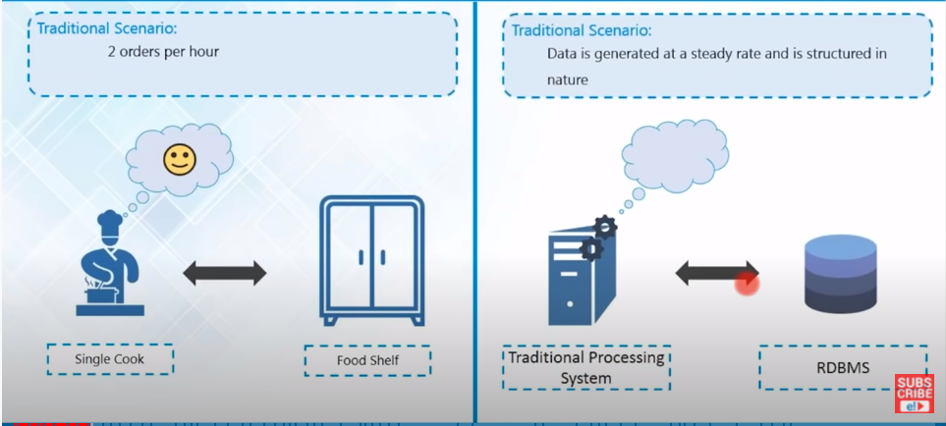
Traditional Scenario

Slide 6
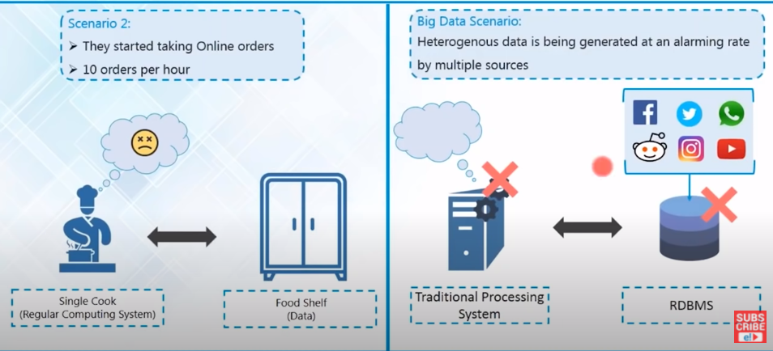
Failure of Traditional system

Slide 7
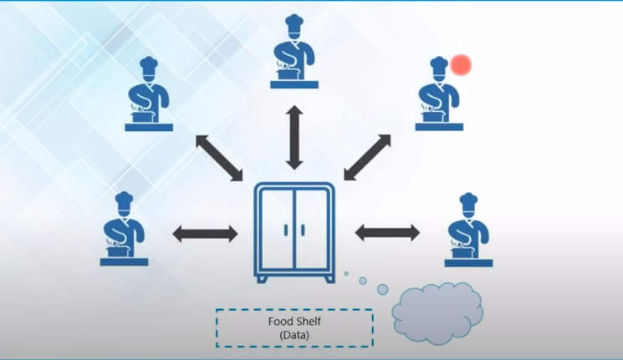
Need effective solution
Issue : Food shelf becomes the bottleneck.

Slide 8
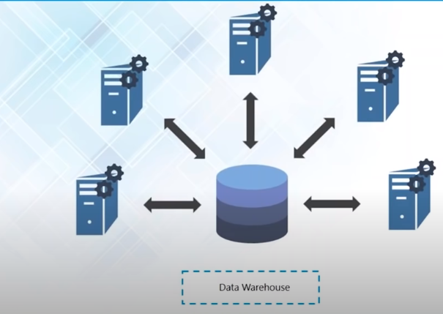
Issue: Bringing data to processing generated lots of Network overhead

Slide 9
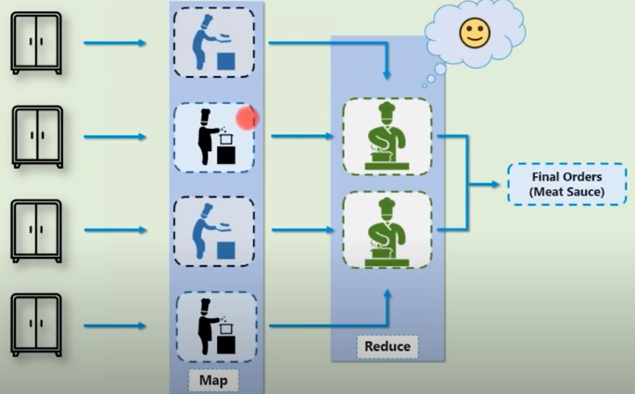
Effective solution
Divided the job into different task. This solution is scalable too.

Slide 10
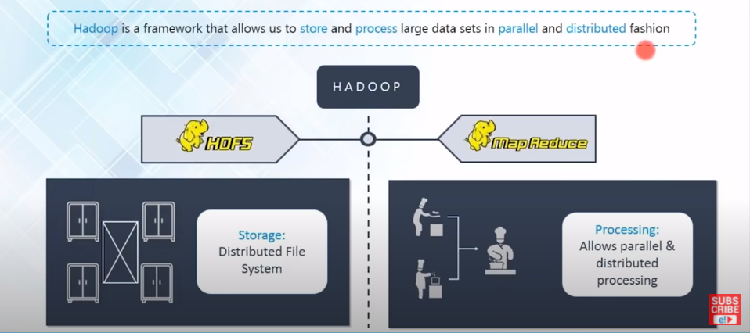
In Hadoop data is distributed across various clusters. MapReduce is the programming unit of Hadoop system.

Slide 11
Hadoop Core Components
We will study two Hadoop Core components :
Hadoop Distributed File System - distributes data
Map/Reduce - distributes application

Slide 12
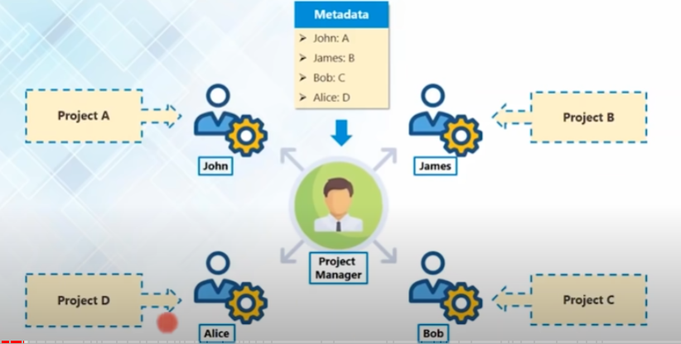
Hadoop: Master/Slave Architecture

Slide 13
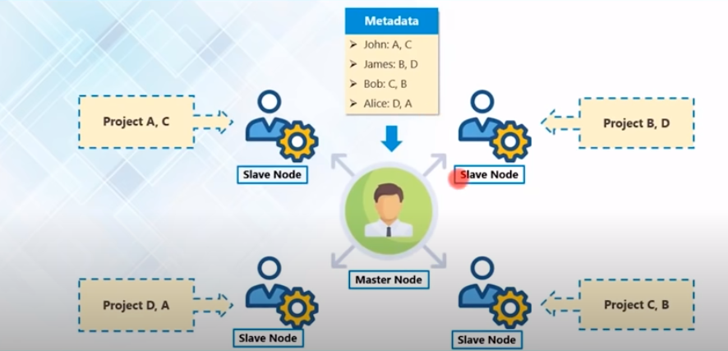

Slide 14
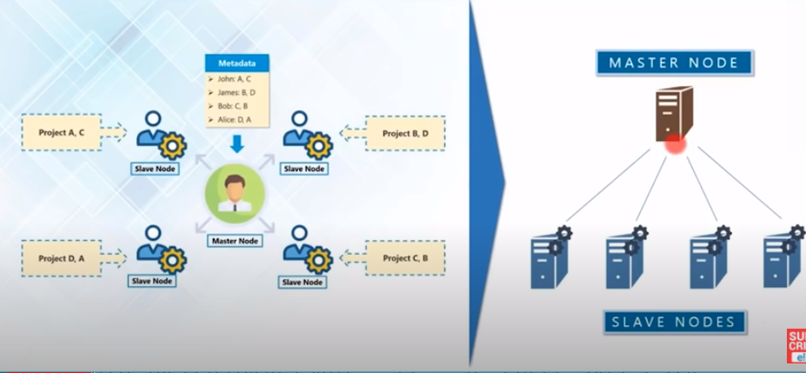
Hadoop Cluster

Slide 15
DFS
A Distributed File System ( DFS ) is simply a classical model of a file system distributed across multiple machines. The purpose is to promote sharing of dispersed files.
This is an area of active research interest today.
Clients should view a DFS the same way they would a centralized FS; the distribution is hidden at a lower level.
A DFS provides high throughput data access and fault tolerance.

Slide 16
HDFS
HDFS core components :
NameNode
DataNode
Secondary NameNode

Slide 17
HDFS
A distributed file system that provides high-throughput access to application data
HDFS uses a master/slave architecture in which one device (master) termed as NameNode controls one or more other devices (slaves) termed as DataNode.
It breaks Data/Files into small blocks (64MB/128 MB each block) and stores on DataNode and each block replicates on other nodes to accomplish fault tolerance.
NameNode keeps the track of blocks written to the DataNode.

Slide 18
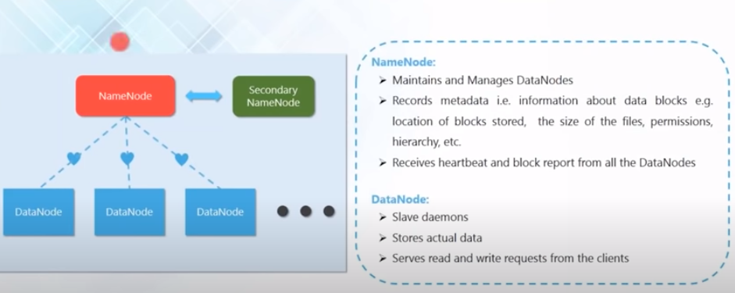

Slide 19
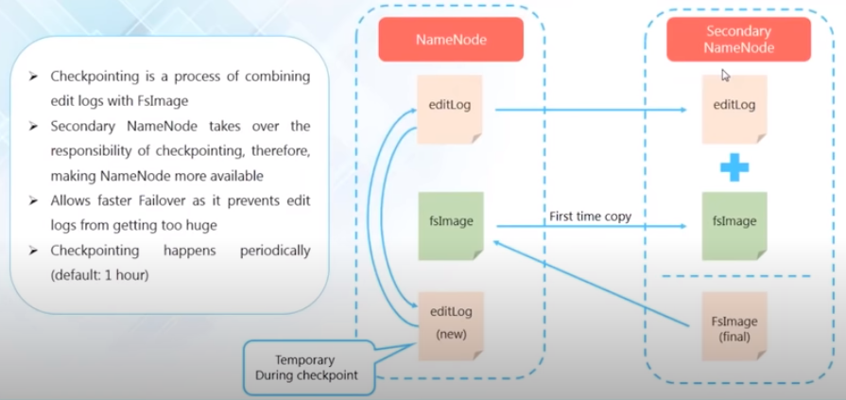
Secondary NameNode and checkpoint
It is not a backup for the NameNode. Here we are talking about the metadata a i.e. data about data, which is handled by fsImage and editLog. fsImage keeps all the updates ever since the NameNode has started. We store it on disk. editLog also contains the metadata, but only the most recent changes. This file is small and resided in RAM of NameNode machine

Slide 20
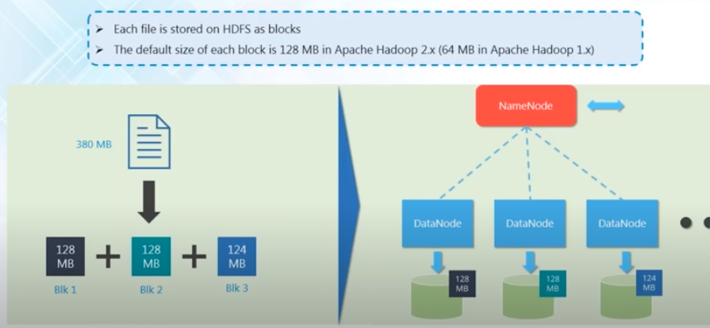
HDFS Data Block
Each block is distributed over DataNode. In last DataNode 4MB have been saved.

Slide 21
Advantages of DFS
suppose we have a Hadoop cluster with 4 machines (1 NameNode + 3 DataNode) with capacity of each DataNode as 1 TB. Now if we want to store a file of 3TB so file will be distributed over 3 DataNode and 1TB will be occupied in each DataNode. So HDFS handles it and provide us as an abstraction the we have a single machine with a capacity of 3TB.
Suppose we want to save a file of 4 TB instead of 3 TB and my cluster capacity is only of 3 TB. So we can add one more DataNode in our cluster in order to fit our requirements. In order to fit our requirement we can keep on adding Nodes to our cluster. (So it is highly scalable)
Suppose we have one high-end computer with a processing power of processing 1TB data in 4 secs. So if we are distrusting our file over 4 such machines then it will take ¼ of time.

Slide 22
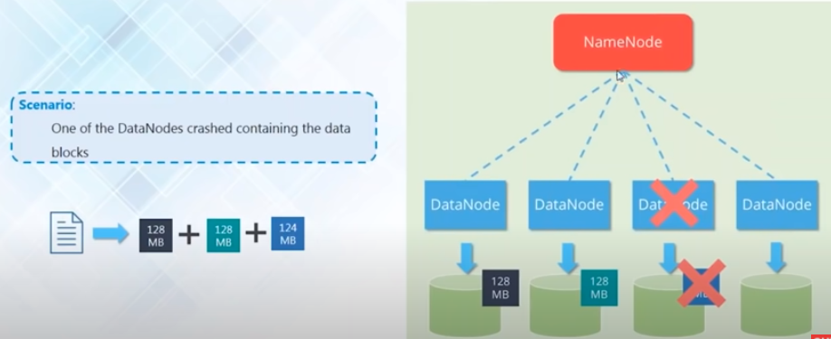
Fault Tolerance or dealing with DataNode failure

Slide 23
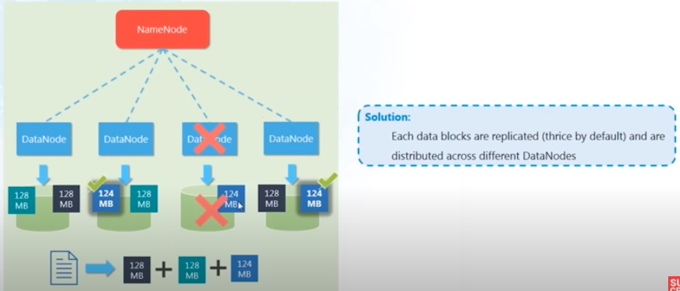
Solution: Replication Factor
As we are using commodity hardware so it is quite possible that failure may occur.

Slide 24
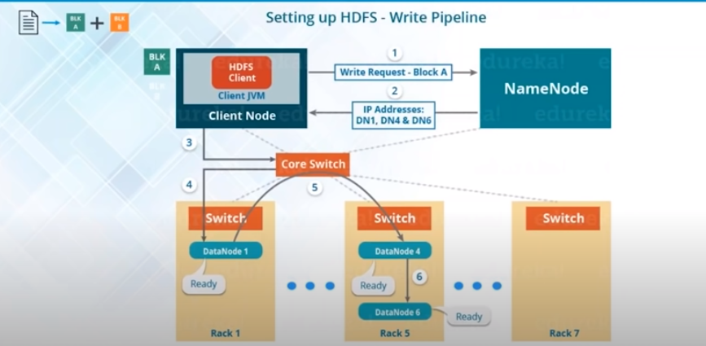
HDFS write mechanism –Pipeline setup

Slide 25
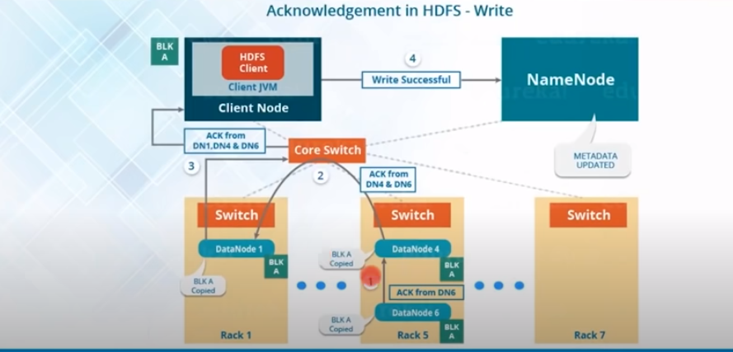
HDFS write mechanism – Acknowledgement

Slide 26
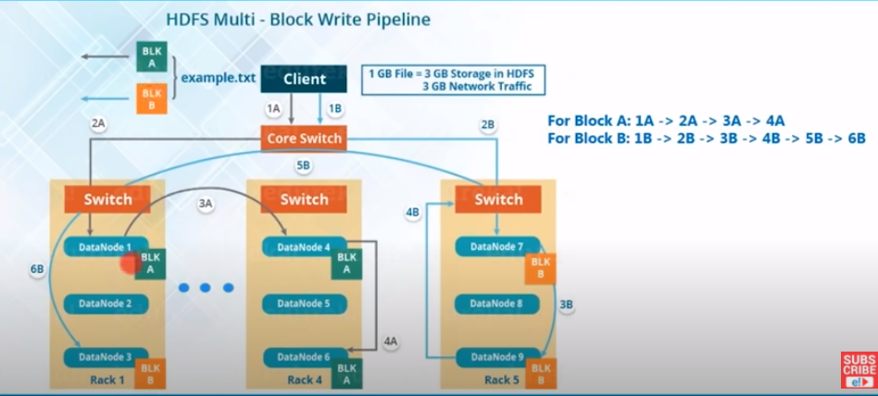
HDFS- multi Block write mechanism

Slide 27
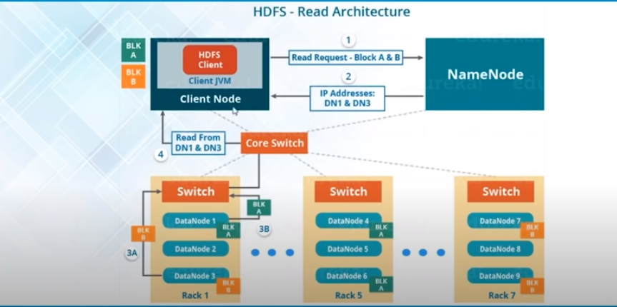
HDFS read mechanism

Slide 28
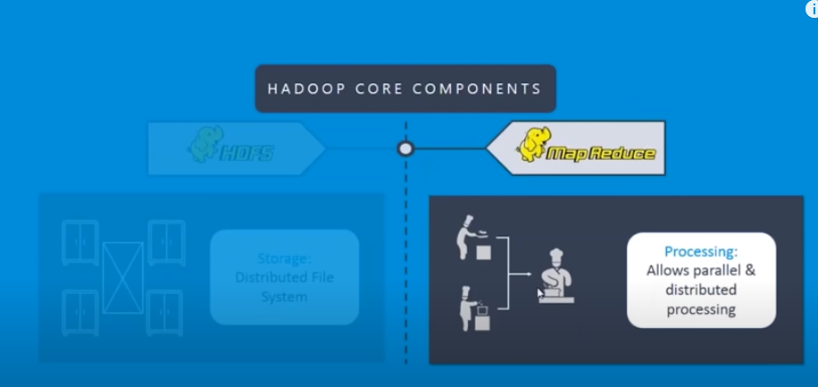
mapReduce

Slide 29
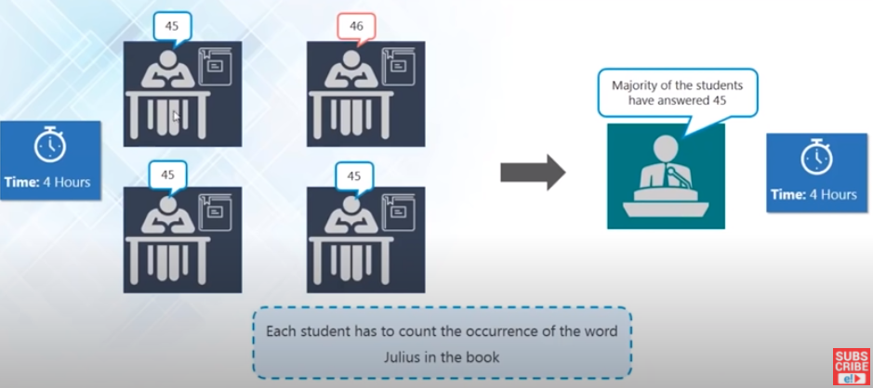

Slide 30
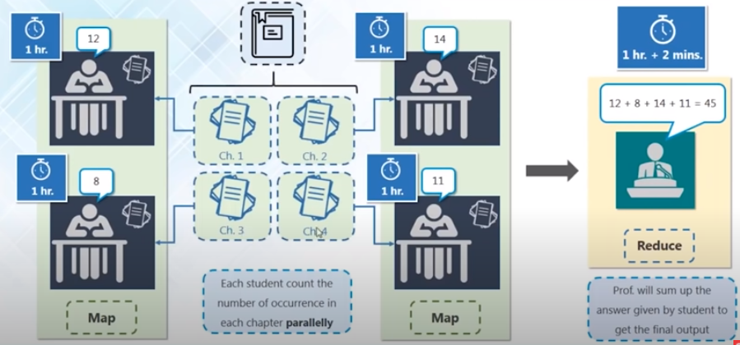

Slide 31
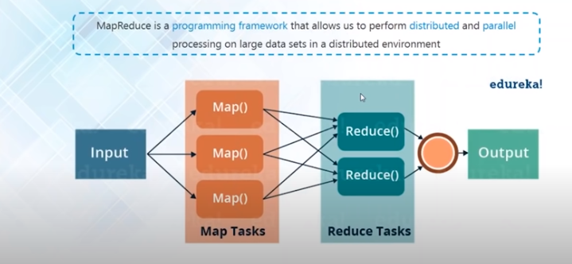

Slide 32
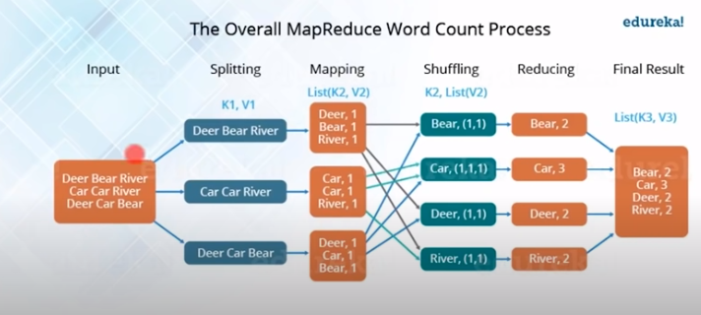
MapReduce word count program

Slide 33
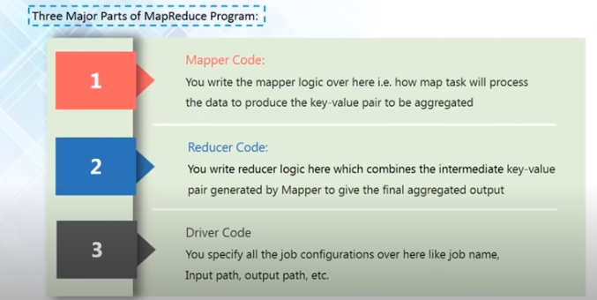

Slide 34
Thankyou

